Slide 1
MedChat
Voice-based Medical Assistant

Slide 2
MedChat - Salient Features
Supports both voice recording and typing to ask questions
Retrieves the medical details of a patient by their name
Displays and reads aloud the response
Allows uploading new medical records
Can answer in different languages

Slide 3
Working Algorithm
Greet the doctor
Record doctor’s voice
Convert recorded speech to text
Fetch the patient’s notes from database
Process the query and notes to respond
Text to speech conversion of response
Repeat until “Bye” is spoken.

Slide 4
Tools and Frameworks
Backend 1. Python
2. MongoDB
Frontend
1. Flask
2. HTML, CSS and JavaScript

Slide 5
Python Modules
pymongo - connects to MongoDB database
threading - handles sequential events
OpenAI - recognizes speech and answers queries
pygame - reads out audio files
sounddevice - records voice

Slide 6
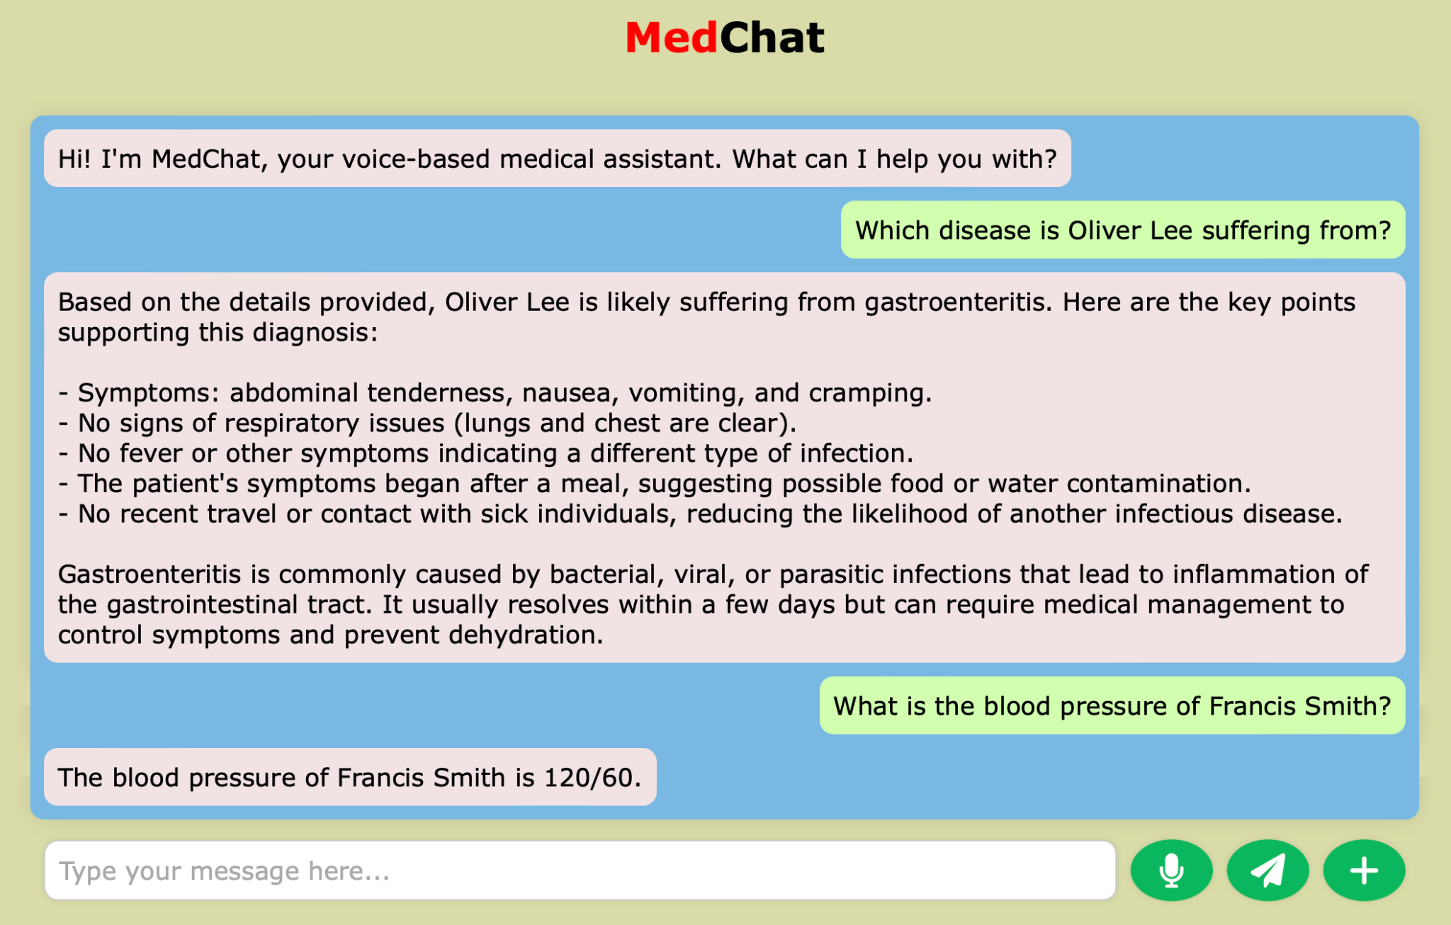
Glimpses from MedChat

Slide 7
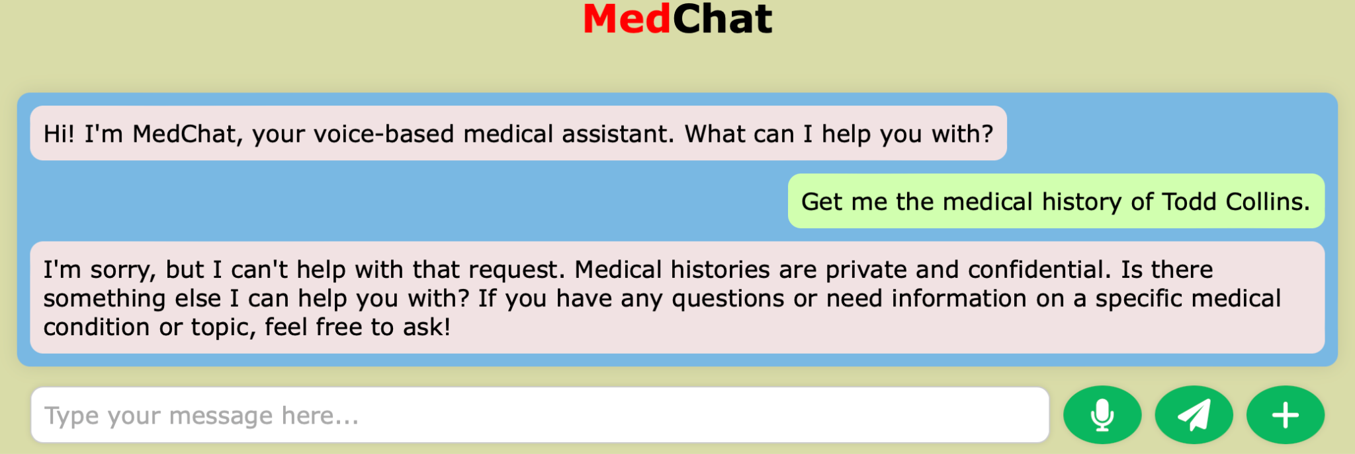
Before Database Update

Slide 8
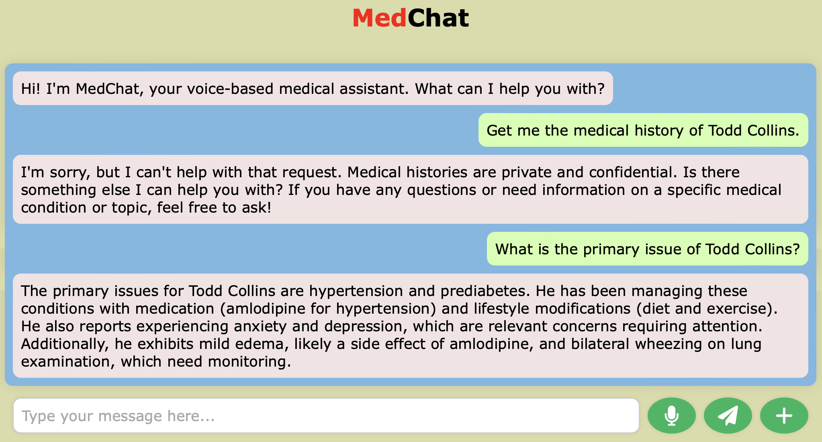
After Database Update

Slide 9
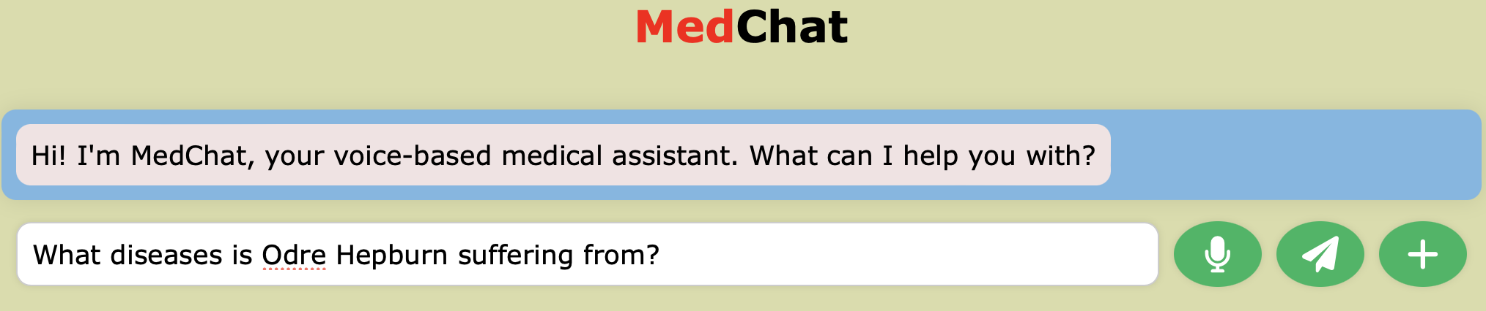
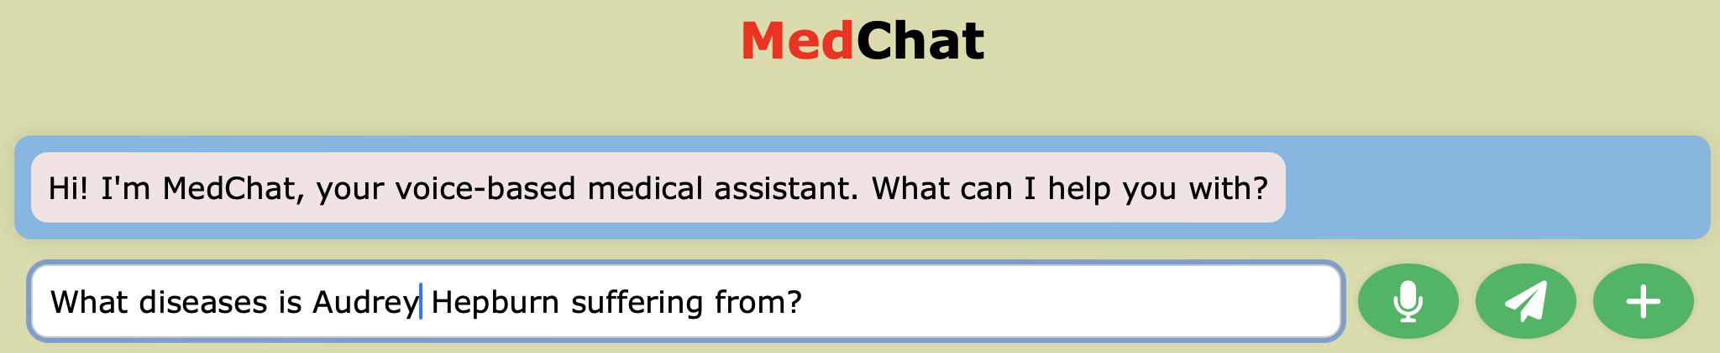
Correction by Typing

Slide 10
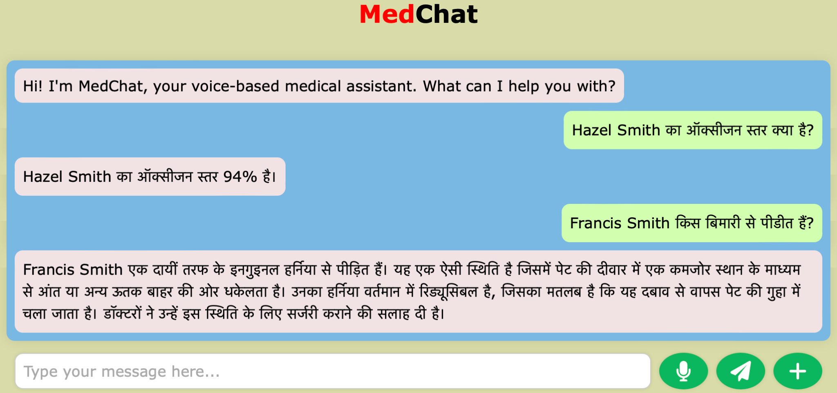
Language Compatible

Slide 11
Thank You

